Slide 1
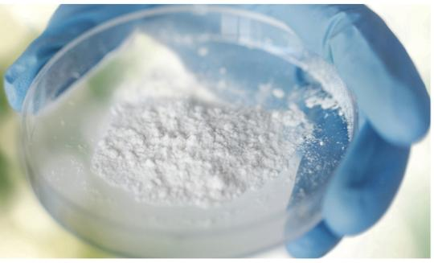
INVESTOR RELATIONS
Aluminium Dross
Upcycling
Commercially demonstrated recovery of ultra-fine aluminium hydroxide from secondary aluminium dross
SJ MONOTECH
Technology validated through one year of demo plant operation
Notes:
[Sources]
- User-provided source: 250415-SJ MONOTECH Dross IR.pdf, page 1.
- Demonstration operating period and production/export quantities supplied by management.
[/Sources]

Slide 2
INVESTMENT HIGHLIGHTS
A demonstrated technology ready for commercial scale-up
The investment case is built on operating evidence, product validation and a defined expansion pathway.
150 t/y
~12 months
~30 t
~5 t
DEMO PLANT CAPACITY
ACTUAL OPERATION
PRODUCT PRODUCED
PRODUCT EXPORTED
Why this matters
Commercial evidence
• Technology verified beyond the laboratory
• Actual secondary aluminium dross processed
• Ultra-fine aluminium hydroxide manufactured and evaluated
• Operating data used as the basis for the planned 15,000 t/y commercial facility
Plant operation
Product quality
Customer evaluation
Export experience
Scale-up engineering basis
SJ MONOTECH | ALUMINIUM DROSS UPCYCLING
02
Notes:
[Sources]
- User-provided source: 250415-SJ MONOTECH Dross IR.pdf.
- Demonstration operating period and production/export quantities supplied by management.
[/Sources]

Slide 3
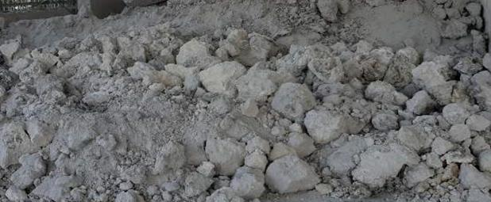
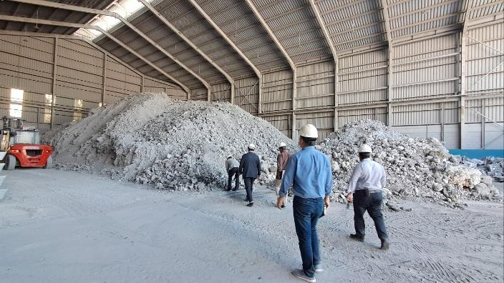
INDUSTRIAL PROBLEM
Aluminium dross still contains value after metal recovery
The non-metallic fraction is often landfilled or sold into low-value applications.
The current loss of value
• Residual aluminium-bearing compounds remain after metal separation
• Disposal costs and environmental liabilities continue to rise
• Conventional routes often focus on metal recovery, not final residue upgrading
• A circular solution must create marketable products from the remaining fraction
The opportunity
Convert aluminium-bearing waste into specialty-grade material rather than treating it only as a disposal problem.
SJ MONOTECH | ALUMINIUM DROSS UPCYCLING
03
Notes:
[Sources]
- User-provided source: 250415-SJ MONOTECH Dross IR.pdf, page 7.
- Demonstration operating period and production/export quantities supplied by management.
[/Sources]

Slide 4
INDUSTRY GAP
Metal recovery alone does not complete the circular economy
Many existing routes improve metal yield but leave a difficult final residue.
01
02
03
Recover metal
Manage residue
Upgrade the residue
• Mechanical separation
• Melting and alloy recovery
• Value concentrated in metallic fraction
• Bulk oxide outlets
• Cement or construction use
• Continued disposal exposure
• Recover aluminium compounds
• Control purity and particle size
• Produce higher-value ATH
SJ Monotech focuses on the third step.
SJ MONOTECH | ALUMINIUM DROSS UPCYCLING
04
Notes:
[Sources]
- User-provided source: 250415-SJ MONOTECH Dross IR.pdf, page 14.
- Demonstration operating period and production/export quantities supplied by management.
[/Sources]

Slide 5
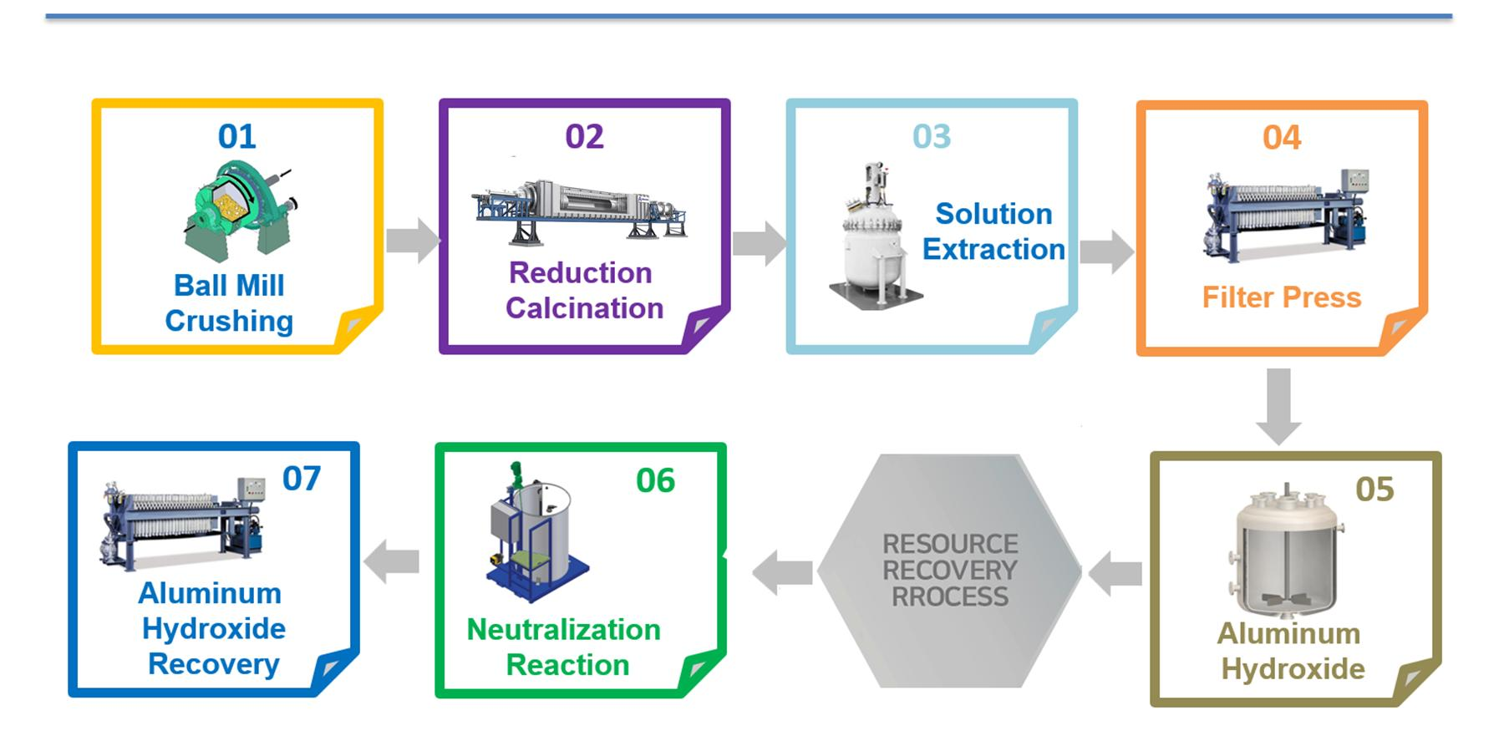
TECHNOLOGY CONCEPT
A reverse approach to the conventional bauxite-to-alumina route
Instead of importing a natural ore, the process recovers aluminium value already present in industrial waste.
Conventional pathway
Bauxite → Al(OH)₃ → Al₂O₃
SJ Monotech pathway
Secondary dross → purified Al-bearing solution → Al(OH)₃
A circular feedstock pathway designed to recover material value and reduce landfill dependence.
SJ MONOTECH | ALUMINIUM DROSS UPCYCLING
05
Notes:
[Sources]
- User-provided source: 250415-SJ MONOTECH Dross IR.pdf, page 8.
- Demonstration operating period and production/export quantities supplied by management.
[/Sources]

Slide 6
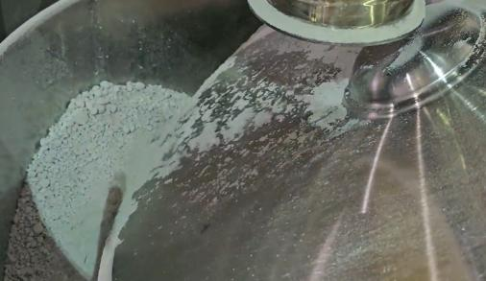
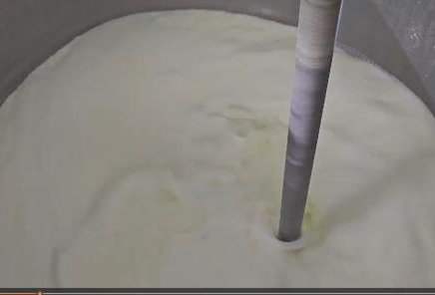
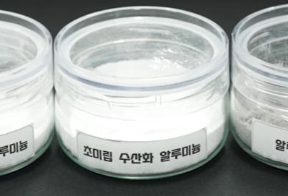
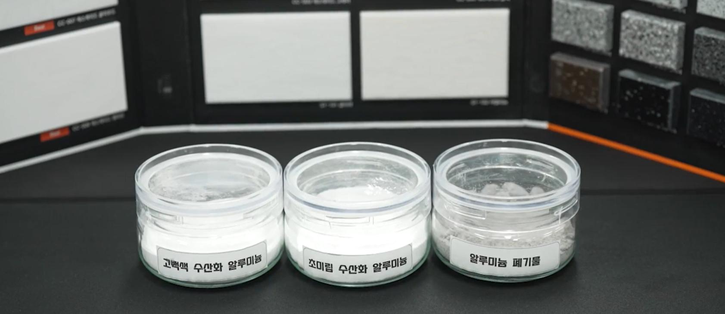
CORE PROCESS
The process controls each step from feed preparation to product finishing
The operating sequence was tested at the demonstration facility.
1
2
3
4
5
→
→
→
→
Feed preparation
Controlled reaction
Solid-liquid separation
Precipitation and refining
Drying and classification
SJ MONOTECH | ALUMINIUM DROSS UPCYCLING
06
Notes:
[Sources]
- User-provided source: 250415-SJ MONOTECH Dross IR.pdf, page 13.
- Demonstration operating period and production/export quantities supplied by management.
[/Sources]

Slide 7
TECHNOLOGY READINESS
The project has moved beyond laboratory development
Commercial scale-up follows a completed sequence of development, operation and market validation.
01
Laboratory development
Completed
Patent development and process testing
02
150 t/y demonstration plant
Completed and operated
Approximately one year of actual operation
03
Product and export validation
Completed
Product production, analysis and export experience
04
15,000 t/y commercial plant
Scale-up stage
Engineering and financing for commercial deployment
SJ MONOTECH | ALUMINIUM DROSS UPCYCLING
07
Notes:
[Sources]
- User-provided source: 250415-SJ MONOTECH Dross IR.pdf, page 27.
- Demonstration operating period and production/export quantities supplied by management.
[/Sources]

Slide 8
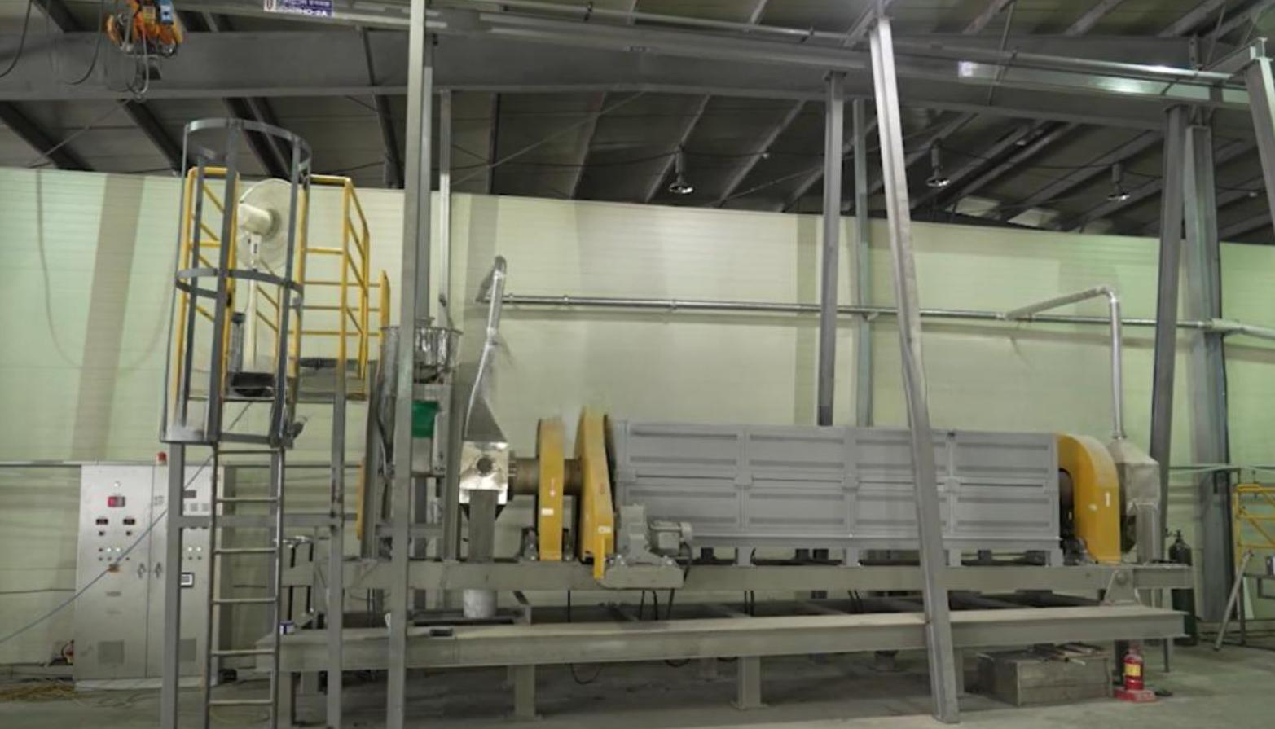
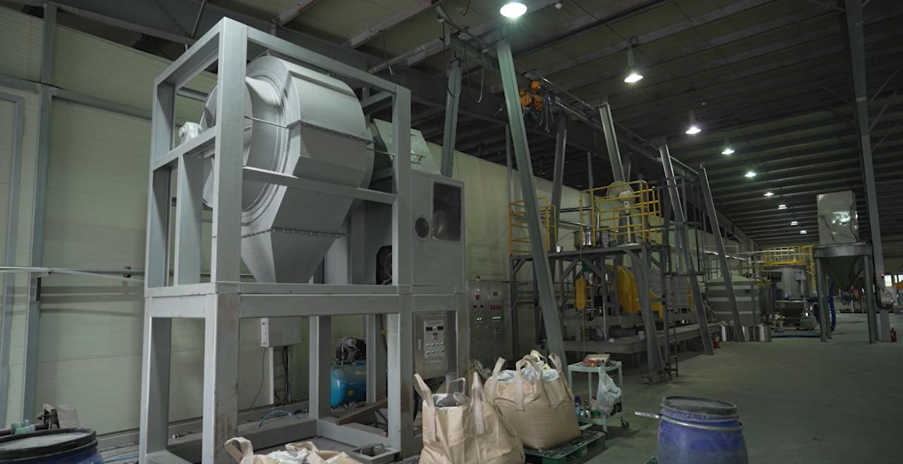
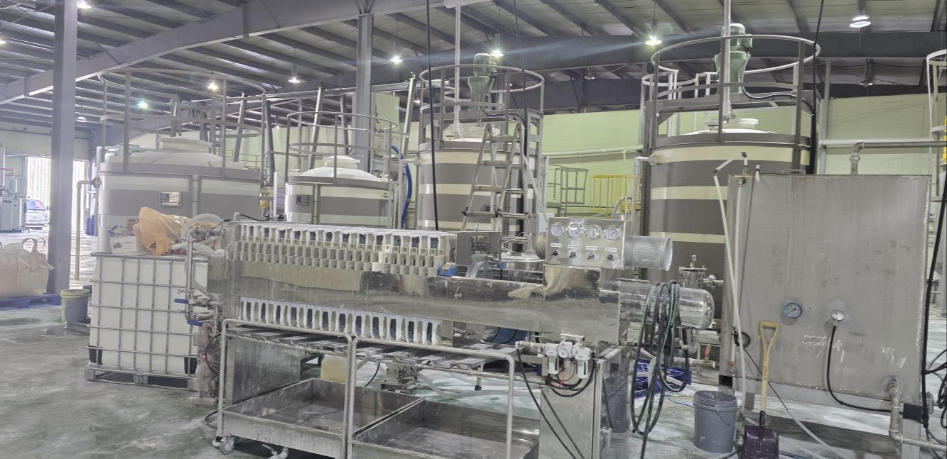
DEMONSTRATION EVIDENCE
One year of plant operation created the scale-up data
The demonstration facility processed actual feedstock and validated the integrated operating sequence.
150 t/y
~12 months
NAMEPLATE CAPACITY
OPERATING PERIOD
Data generated
• Mass balance and recovery performance
• Reagent and utility consumption
• Equipment operating conditions
• Product quality and consistency
• Labour and maintenance requirements
SJ MONOTECH | ALUMINIUM DROSS UPCYCLING
08
Notes:
[Sources]
- User-provided source: 250415-SJ MONOTECH Dross IR.pdf, page 45.
- Demonstration operating period and production/export quantities supplied by management.
[/Sources]

Slide 9
COMMERCIAL VALIDATION
Products were manufactured, evaluated and exported
The project has already completed the first commercial steps beyond pilot-scale experimentation.
~30 t
~5 t
ACTUAL PRODUCT PRODUCED
PRODUCT EXPORTED
Evidence package for due diligence
• Production logs and batch records
• Particle-size and whiteness test results
• Customer sample evaluations
• Commercial invoices and export documentation
• Operating photos and equipment records
SJ MONOTECH | ALUMINIUM DROSS UPCYCLING
09
Notes:
[Sources]
- User-provided source: 250415-SJ MONOTECH Dross IR.pdf, page 44.
- Demonstration operating period and production/export quantities supplied by management.
[/Sources]

Slide 10
DEMONSTRATED MASS BALANCE
Recovery and production metrics must be defined separately
Product output can exceed feed weight because reagents and co-product components are incorporated into the final material streams.
Up to 92%
~1.15 t
15,000 t/y
RECOVERY OF RECOVERABLE ALUMINIUM-BEARING CONSTITUENTS
COMBINED PRODUCTS AND CO-PRODUCTS PER TONNE OF DRY DROSS
PLANNED COMMERCIAL DRY-DROSS FEED CAPACITY
Recommended investor interpretation
The 92% figure describes recovery performance, while the approximately 1.15 t/t figure describes total saleable products and co-products after reaction and material addition. These figures should not be presented as the same metric.
SJ MONOTECH | ALUMINIUM DROSS UPCYCLING
10
Notes:
[Sources]
- User-provided source: 250415-SJ MONOTECH Dross IR.pdf, page 39.
- Demonstration operating period and production/export quantities supplied by management.
[/Sources]

Slide 11
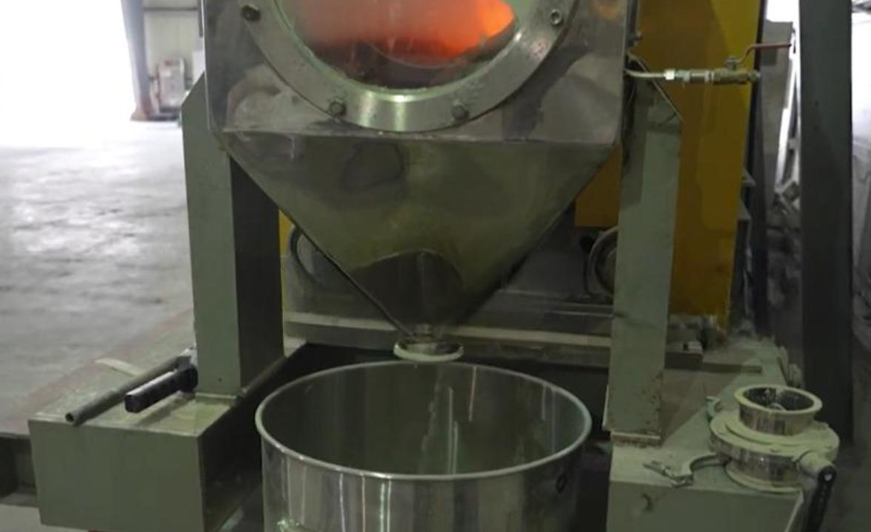
PRODUCT QUALITY
The demonstrated product matches the required fine-particle range
Product positioning should be supported by analysis data, not only by promotional claims.
3.02 μm
99.6%
3.79 μm
SJ MONOTECH MEAN PARTICLE SIZE
SJ MONOTECH WHITENESS
REFERENCE COMPETITOR PARTICLE SIZE
Commercial meaning
• Controlled particle size
• High whiteness
• Potentially easier formulation
• Broader specialty-filler applications
SJ MONOTECH | ALUMINIUM DROSS UPCYCLING
11
Notes:
[Sources]
- User-provided source: 250415-SJ MONOTECH Dross IR.pdf, page 40.
- Demonstration operating period and production/export quantities supplied by management.
[/Sources]

Slide 12
PRODUCT PORTFOLIO
Ultra-fine ATH is the primary commercial product
Higher-value alumina products are treated as expansion opportunities, not as base-case revenue.
Primary product
Standard grade
Ultra-fine aluminium hydroxide
Aluminium hydroxide
Flame-retardant fillers, cables, polymers, coatings and adhesives
Chemical intermediates, zeolite, glass fibre and catalyst carriers
Development product
Specialty opportunity
Hemispherical alumina
Platelet alumina
Heat-management, ceramic and specialty applications
Reference specialty market only; excluded from the base financial projection
SJ MONOTECH | ALUMINIUM DROSS UPCYCLING
12
Notes:
[Sources]
- User-provided source: 250415-SJ MONOTECH Dross IR.pdf, page 15.
- Demonstration operating period and production/export quantities supplied by management.
[/Sources]

Slide 13
COMPETITIVE POSITION
SJ Monotech targets residue upgrading, not only metal recovery
The differentiation is the conversion of the aluminium-bearing fraction into specialty-grade material.
Primary focus
Conventional dross recycling
SJ Monotech
Value recovered
Aluminium metal
Metal + aluminium-bearing compounds
Residue outlet
Disposal or bulk-grade use
ATH and usable co-products
Product position
Commodity / bulk input
Specialty functional material
Technology status
Established metal recovery
Demonstrated integrated upgrading
SJ MONOTECH | ALUMINIUM DROSS UPCYCLING
13
Notes:
[Sources]
- User-provided source: 250415-SJ MONOTECH Dross IR.pdf, page 14.
- Demonstration operating period and production/export quantities supplied by management.
[/Sources]

Slide 14
ENVIRONMENTAL VALUE
The process is designed for high resource utilization with controlled risk
Claims are stated as demonstrated design objectives rather than absolute “zero-risk” promises.
Design priorities
• Reduce landfill dependence
• Avoid highly hazardous leaching reagents
• Control water-reactive feedstock risk
• Recover saleable material streams
• Use suitable co-products in cementitious applications
Responsible wording
“Designed for near-total resource utilization” is more credible than an unsupported claim of absolute zero waste.
SJ MONOTECH | ALUMINIUM DROSS UPCYCLING
14
Notes:
[Sources]
- User-provided source: 250415-SJ MONOTECH Dross IR.pdf, page 16.
- Demonstration operating period and production/export quantities supplied by management.
[/Sources]

Slide 15
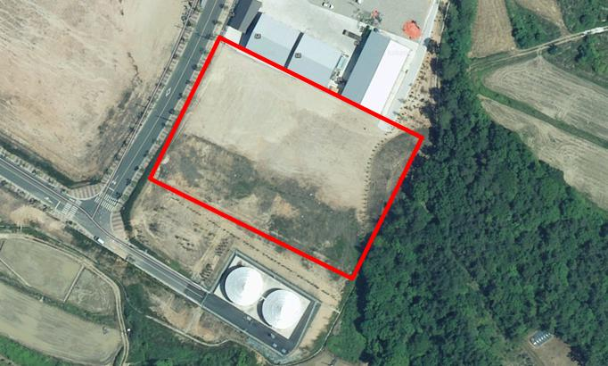
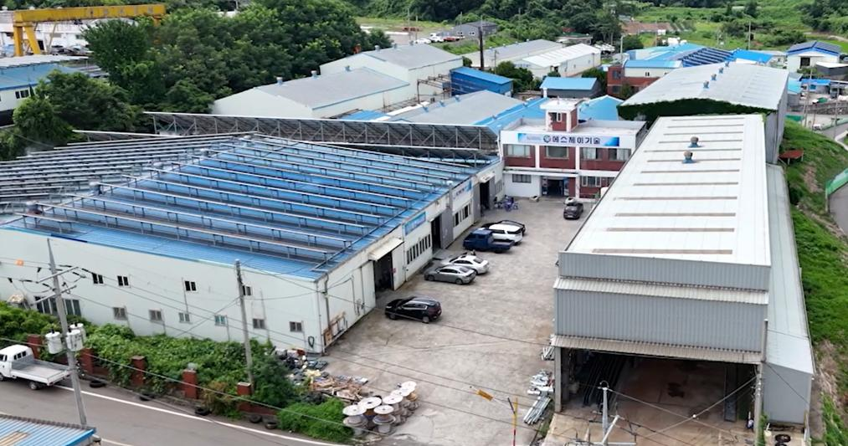
COMMERCIAL SCALE-UP
A modular 15,000 t/y facility follows the demonstrated process
The commercial design uses demo operating data as the engineering basis.
15,000 t/y
17,250 t/y
DRY-DROSS FEED CAPACITY
COMBINED PRODUCT OUTPUT USED IN THE FINANCIAL MODEL
Scale-up basis
• Demonstrated unit operations
• Operating mass balance
• Measured product specifications
• Commercial equipment sizing
• Local utility and feedstock conditions
SJ MONOTECH | ALUMINIUM DROSS UPCYCLING
15
Notes:
[Sources]
- User-provided source: 250415-SJ MONOTECH Dross IR.pdf, page 27.
- Demonstration operating period and production/export quantities supplied by management.
[/Sources]

Slide 16
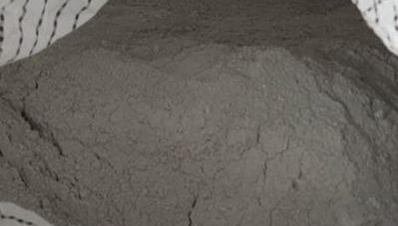
FEEDSTOCK STRATEGY
The Gulf region offers concentrated industrial feedstock
Commercial deployment should begin with representative sampling and a verified long-term supply plan.
Required before final design
• Annual available volume
• Metallic Al and Al₂O₃ content
• Salt and moisture content
• Particle-size distribution
• Impurity profile
• Current disposal cost
• Target product specification
• Offtake and co-product outlets
SJ MONOTECH | ALUMINIUM DROSS UPCYCLING
16
Notes:
[Sources]
- User-provided source: 250415-SJ MONOTECH Dross IR.pdf, page 7.
- Demonstration operating period and production/export quantities supplied by management.
[/Sources]

Slide 17
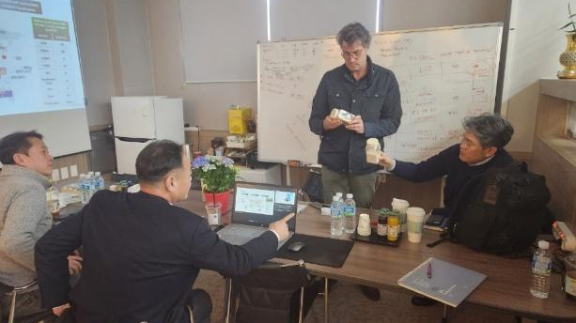
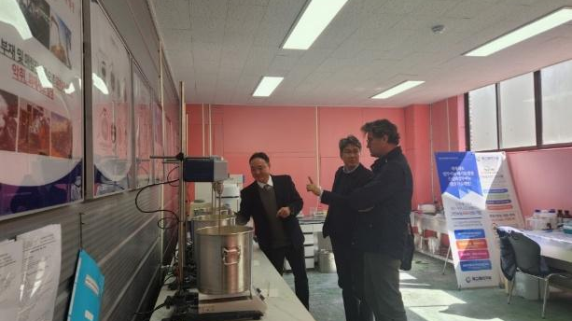
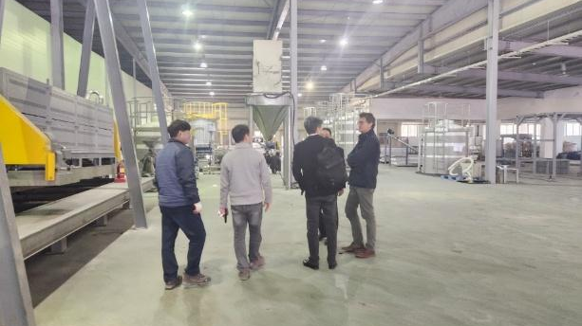
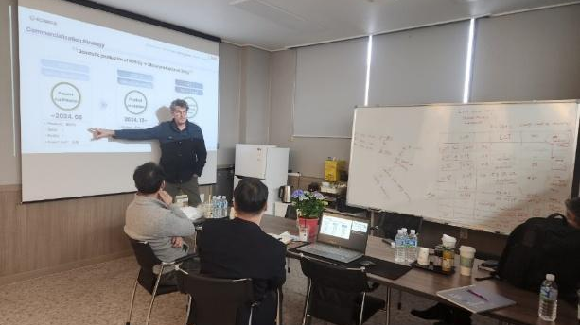
CUSTOMER VALIDATION
Product evaluations confirm market interest - not yet guaranteed offtake
Commercial claims are separated clearly from sample evaluations and non-binding purchase intentions.
Validation achieved
• Facility and process reviews
• Primary product sample evaluation
• Positive feedback on whiteness and bulk density
• Requests for larger commercial samples
• Purchase interest subject to stable quality and supply
Position all LOIs as non-binding unless a binding offtake agreement has been executed.
SJ MONOTECH | ALUMINIUM DROSS UPCYCLING
17
Notes:
[Sources]
- User-provided source: 250415-SJ MONOTECH Dross IR.pdf, page 18.
- Demonstration operating period and production/export quantities supplied by management.
[/Sources]

Slide 18
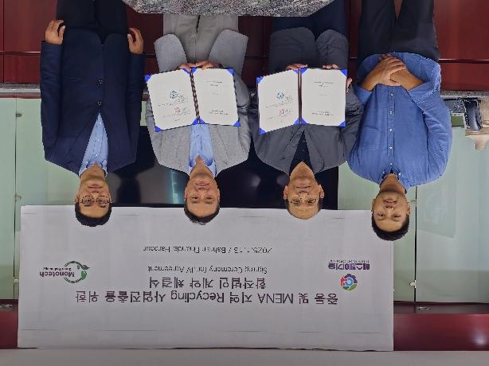
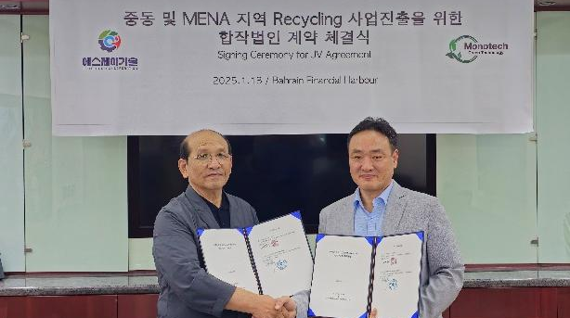
MIDDLE EAST COMMERCIALIZATION
The regional plan combines local feedstock with Korean process know-how
A phased structure reduces execution risk while building toward commercial capacity.
Phase 1
Local pilot / feedstock verification
Phase 2
15,000 t/y aluminium dross facility
Phase 3
Expansion into spent-catalyst resource recovery
SJ MONOTECH | ALUMINIUM DROSS UPCYCLING
18
Notes:
[Sources]
- User-provided source: 250415-SJ MONOTECH Dross IR.pdf, page 20.
- Demonstration operating period and production/export quantities supplied by management.
[/Sources]

Slide 19
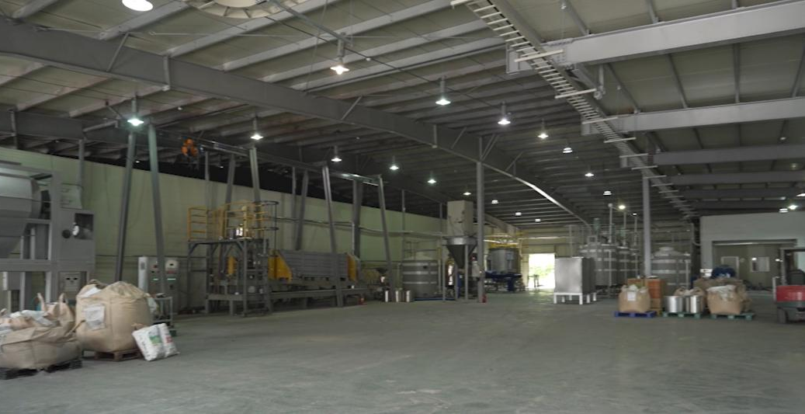
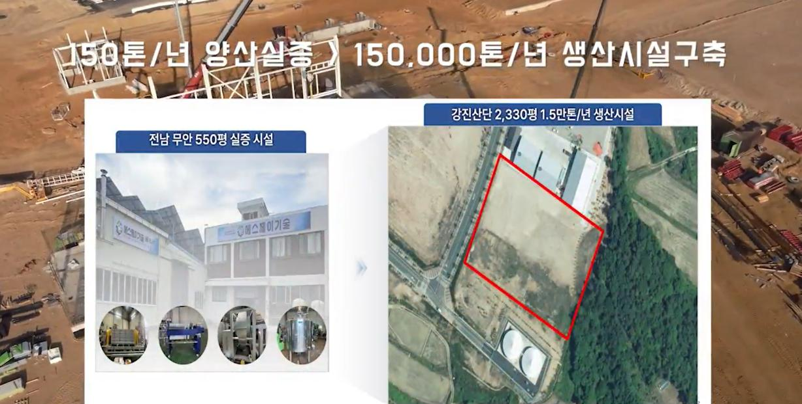
OPERATING FOOTPRINT
Korean facilities provide the demonstration and scale-up foundation
The Muan demonstration plant supports process validation; the Gangjin site supports commercial expansion.
Muan
Demonstration facility
2,000 m²
150 t/y
Gangjin
Industrial complex site
Approx. 8,000 m²
15,000 t/y planned facility
SJ MONOTECH | ALUMINIUM DROSS UPCYCLING
19
Notes:
[Sources]
- User-provided source: 250415-SJ MONOTECH Dross IR.pdf, page 27.
- Demonstration operating period and production/export quantities supplied by management.
[/Sources]

Slide 20
BUSINESS MODEL
Commercialization combines technology, local operation and product sales
The model is adaptable to Korea, the GCC and other regions with concentrated dross generation.
01
02
03
Technology and engineering
Local project company
Product market
Process design
Operating know-how
Quality control
Feedstock contracts
Permitting and operations
Utilities and logistics
ATH sales
Co-product outlets
Specialty-material expansion
Potential structures: joint venture | technology licensing | equipment supply | project development
SJ MONOTECH | ALUMINIUM DROSS UPCYCLING
20
Notes:
[Sources]
- User-provided source: 250415-SJ MONOTECH Dross IR.pdf, page 29.
- Demonstration operating period and production/export quantities supplied by management.
[/Sources]

Slide 21


EXECUTION TEAM
Commercialization requires both technical depth and regional execution
The team combines aluminium materials, process engineering, operations and international business development.
Core execution capabilities
• Aluminium materials and chemical-process development
• Demonstration plant operation and scale-up engineering
• Quality analysis and specialty-product development
• International project development and regional partnerships
• Finance, administration and market development
Hyung Kyu Park
Kyu Pyoung Lim
Chairman / Global Business
Co-Founder / Operations
Governance, titles and current responsibilities should be updated before each investor distribution.
SJ MONOTECH | ALUMINIUM DROSS UPCYCLING
21
Notes:
[Sources]
- User-provided source: 250415-SJ MONOTECH Dross IR.pdf, page 23.
- Demonstration operating period and production/export quantities supplied by management.
[/Sources]

Slide 22
TECHNOLOGY PROTECTION
Patents support the process - operating data strengthens the moat
The most defensible advantage is the combination of IP, demonstrated know-how and product-quality control.
Patent position
Operating know-how
Commercial evidence
• Registered dross-recycling technology
• Supplementary process applications
• Product-related patent strategy
• Ongoing technology certification
• Feedstock conditioning
• Reaction control
• Impurity management
• Precipitation control
• Drying and particle classification
• One-year demo operation
• Actual product production
• Quality analysis
• Customer evaluations
• Export experience
SJ MONOTECH | ALUMINIUM DROSS UPCYCLING
22
Notes:
[Sources]
- User-provided source: 250415-SJ MONOTECH Dross IR.pdf, page 41.
- Demonstration operating period and production/export quantities supplied by management.
[/Sources]

Slide 23
DEVELOPMENT ROADMAP
The next milestone is repeatable commercial operation
Each stage should be tied to a measurable technical and commercial gate.
1
2
3
4
5
Feedstock qualification
Basic engineering
Project financing
Construction and commissioning
Market expansion
Representative samples and supply MoU
Mass balance, equipment list and site utilities
JV terms, CAPEX package and permitting
Commercial plant installation and performance test
Long-term offtake and specialty-product portfolio
SJ MONOTECH | ALUMINIUM DROSS UPCYCLING
23
Notes:
[Sources]
- User-provided source: 250415-SJ MONOTECH Dross IR.pdf.
- Demonstration operating period and production/export quantities supplied by management.
[/Sources]

Slide 24
PROPOSED NEXT STEP
Validate the feedstock.
Define the commercial project.
SJ Monotech can proceed with sample analysis, preliminary mass balance, product targeting, equipment configuration and a project-specific commercial proposal.
Required inputs
SJ MONOTECH
• Annual feedstock volume and source
• Representative chemical composition
• Current treatment and disposal cost
• Target product specification and market
• Preferred cooperation structure
Technology demonstration • Commercial scale-up • Global partnership
Turn industrial waste into verified material value.
Notes:
[Sources]
- User-provided source: 250415-SJ MONOTECH Dross IR.pdf, page 48.
- Demonstration operating period and production/export quantities supplied by management.
[/Sources]

Slide 25
APPENDIX
Financial Analysis
The following pages are reproduced from the original IR material without changing the financial figures or assumptions.
Original financial pages retained as provided
Notes:
[Sources]
- User-provided source: 250415-SJ MONOTECH Dross IR.pdf, page 30.
- Demonstration operating period and production/export quantities supplied by management.
[/Sources]

Slide 26
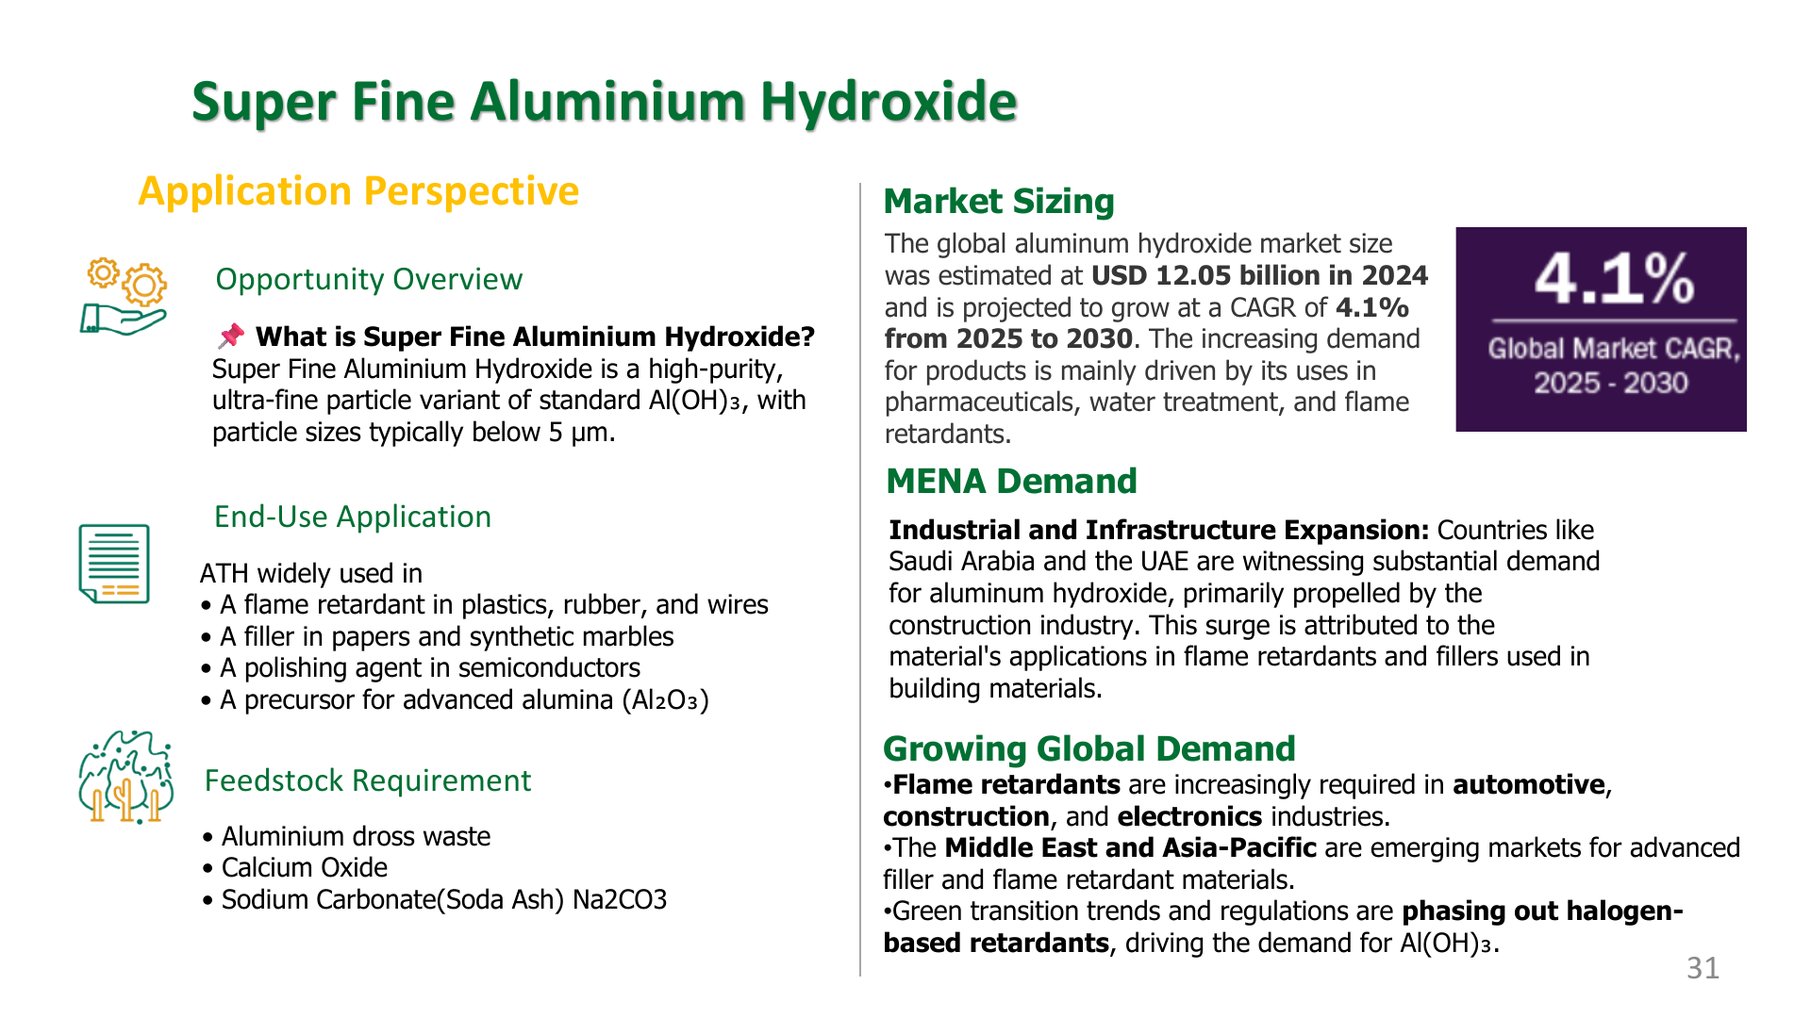
Notes:
[Sources]
- Original financial analysis page reproduced unchanged from 250415-SJ MONOTECH Dross IR.pdf, page 31.
[/Sources]

Slide 27
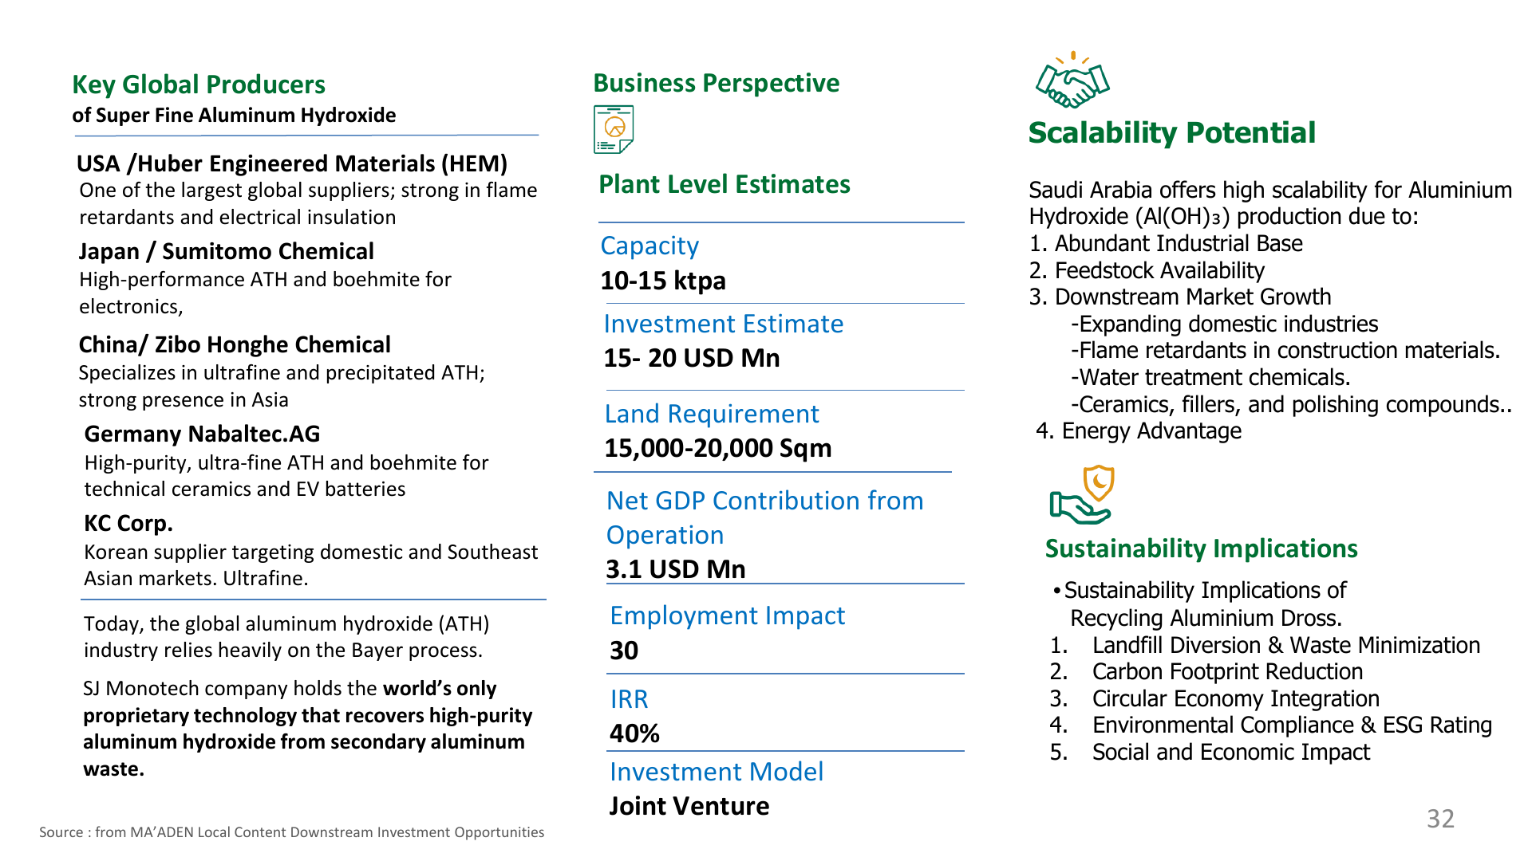
Notes:
[Sources]
- Original financial analysis page reproduced unchanged from 250415-SJ MONOTECH Dross IR.pdf, page 32.
[/Sources]

Slide 28
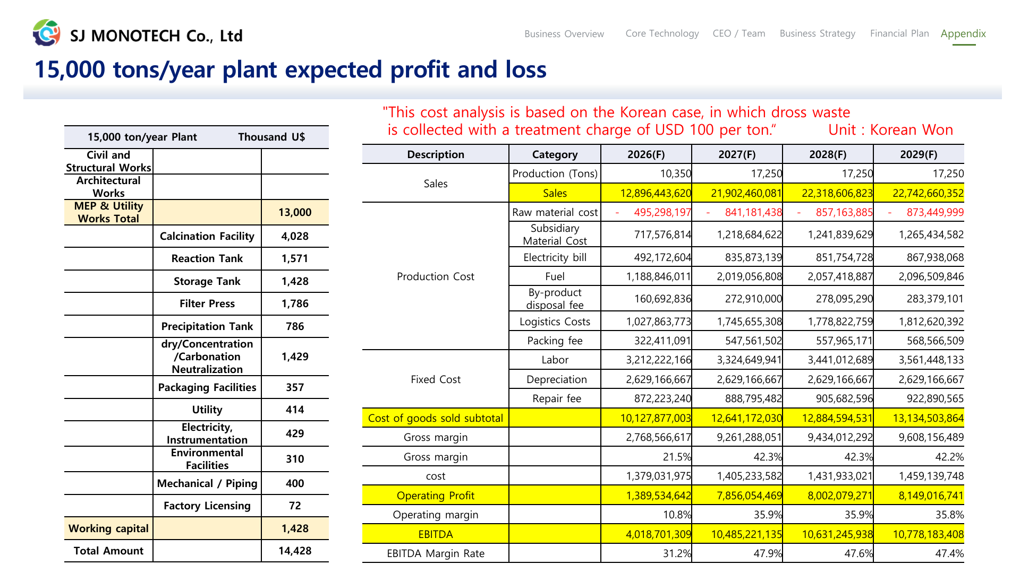
Notes:
[Sources]
- Original financial analysis page reproduced unchanged from 250415-SJ MONOTECH Dross IR.pdf, page 33.
[/Sources]

Slide 29
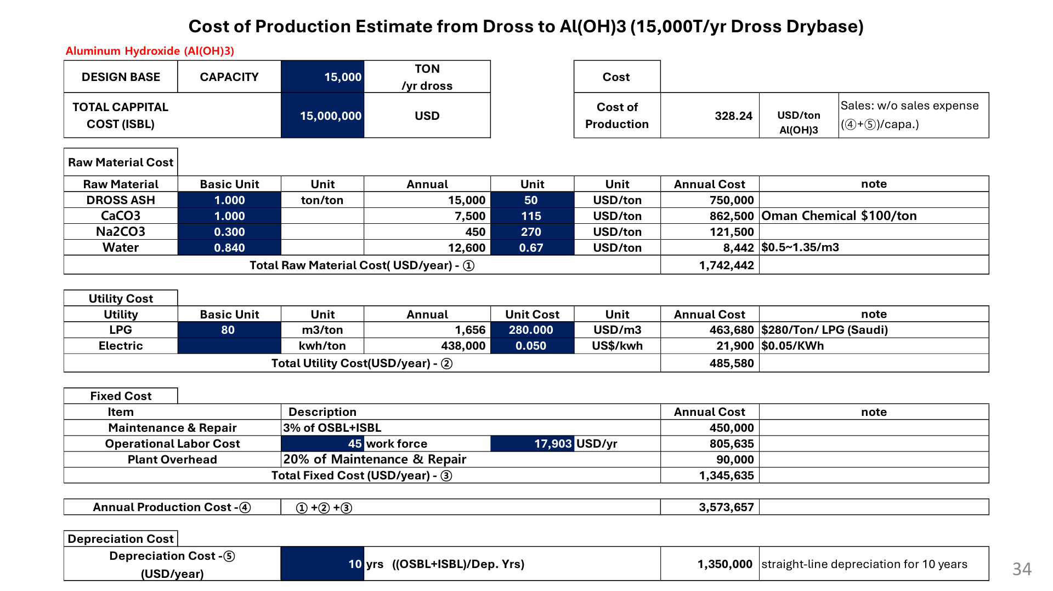
Notes:
[Sources]
- Original financial analysis page reproduced unchanged from 250415-SJ MONOTECH Dross IR.pdf, page 34.
[/Sources]

Slide 30
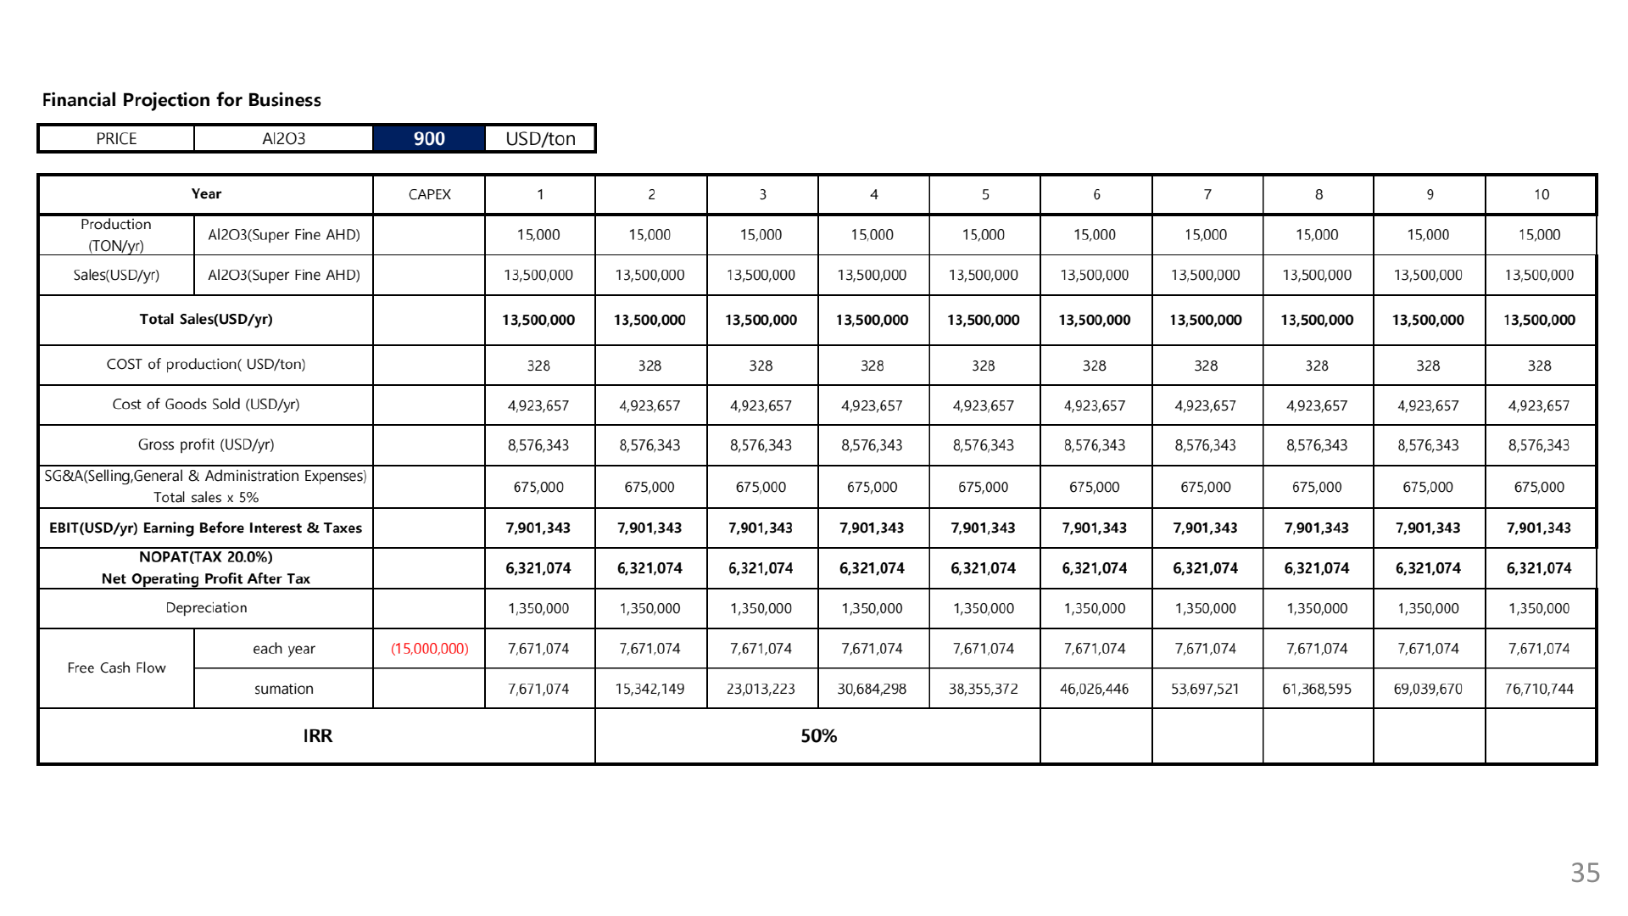
Notes:
[Sources]
- Original financial analysis page reproduced unchanged from 250415-SJ MONOTECH Dross IR.pdf, page 35.
[/Sources]

Slide 31
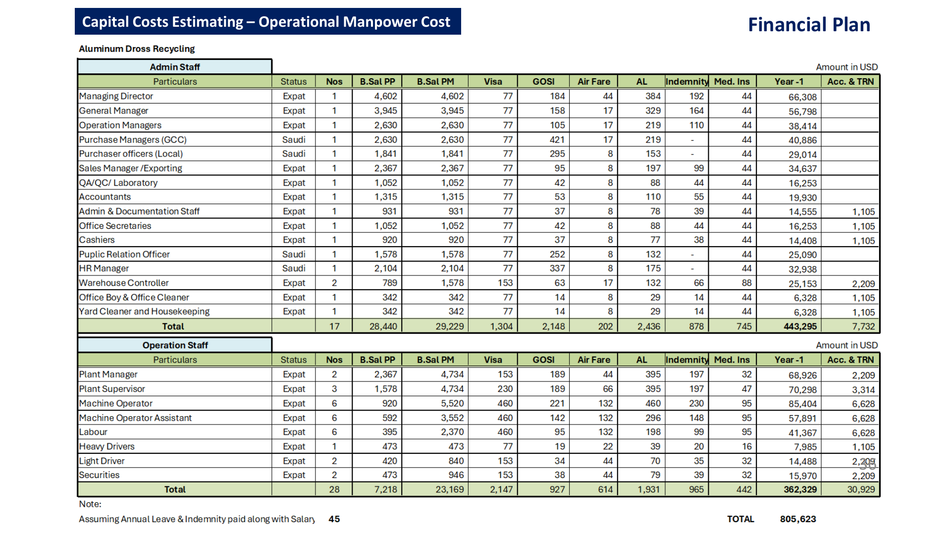
Notes:
[Sources]
- Original financial analysis page reproduced unchanged from 250415-SJ MONOTECH Dross IR.pdf, page 36.
[/Sources]

